Slide 1
Advantages and Disadvantages of e-Book Readers
Eric Moore
Computer Users Group of Greeley
June 11, 2016

Slide 2
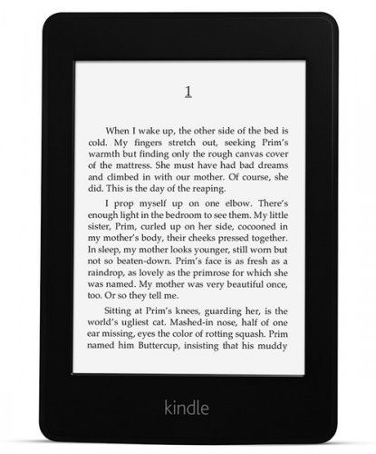
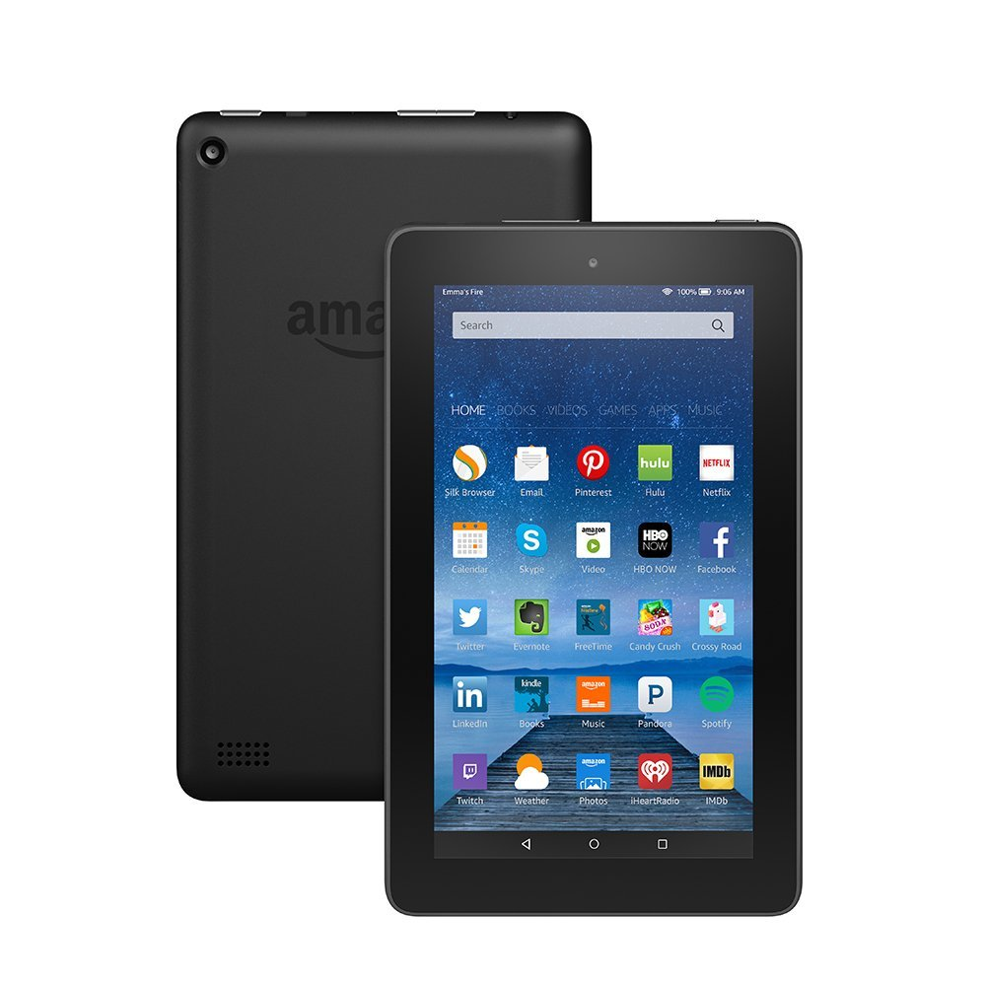
Display Types
E-ink
LCD/Tablet

Slide 3
E-ink Advantages
Lower power usage; longer battery life (weeks)
Readable in dim light
Readable in bright light (no glare)
Easier on the eyes? (debatable based upon a 2012 NIH study)
Cheaper

Slide 4
LCD/Tablet Advantages
Brighter display
Full color (e-ink with color is rare)
Faster processor; faster page transitions
Supports other apps such as games, music, video, and internet surfing

Slide 5

Media Types
E-book Reader
Printed book

Slide 6
E-Book Reader
Hundreds of titles in a small, portable device
Titles may be less expensive than print, or even free!
Quick and easy to acquire new titles
Lightweight (compared with hefty tomes)
Nothing to become stained, creased, or torn
Built-in light source
Highlighting and notes are easily added and changed
Share your notes and highlights with other e-book users
Copy/paste highlights to other media (kindle.amazon.com > Your Highlights)

Slide 7
Where to Get e-Books
Amazon (naturally!)
Fictionwise
Mobipocket
Baen Ebooks
OverDrive through High Plains Library District
Public domain (free)
  Project Gutenberg
  The Internet Archive
  Retroread
  World Public Library
Many other online book sellers

Slide 8
Printed Book
Ease of finding reference material via index
Serendipitous reading (randomly leafing through for interesting passages)
More personal feel (physical touch)
Easier to remember where a passage is
Battery not required (except for a flashlight)
Classy, aesthetic look on a bookshelf*
May be left to your heirs
Cannot be recalled or rescinded
No one to watch what you read and annotate

Slide 9
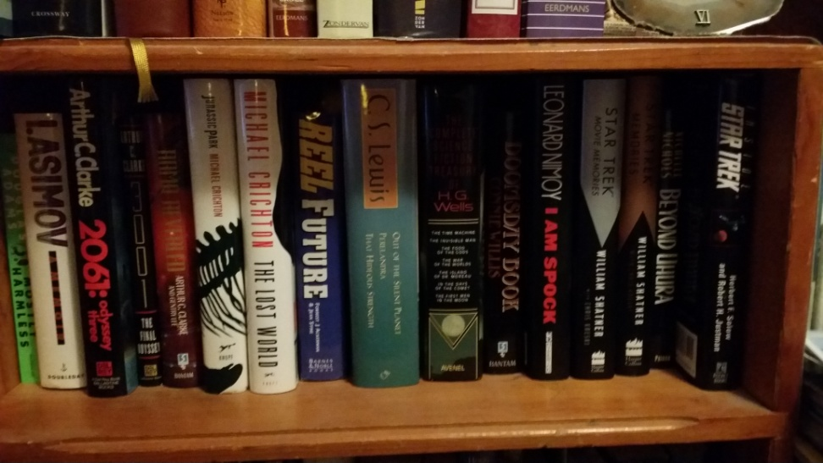
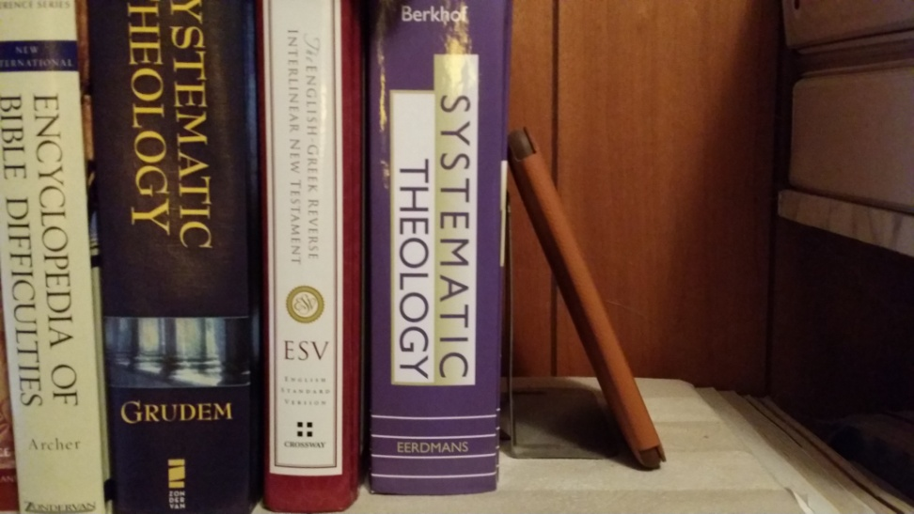
Printed Books v. e-Book Reader
This?
Or This?

Slide 10
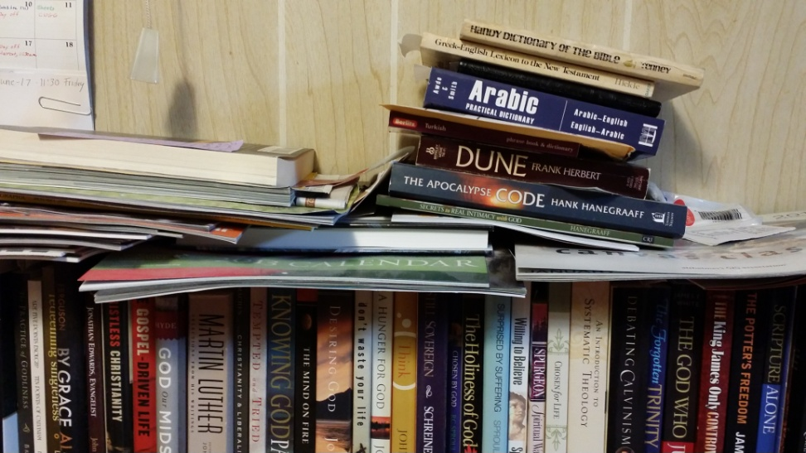
E-Book Reader v. Printed Books
This?
Or This

Slide 11
Resources
E-ink vs. LCD: http://www.howtogeek.com/181577/e-ink-vs.-lcd-which-screen-is-best-for-reading/
Reading on LCD vs. e-Ink displays: effects on fatigue and visual strain: http://www.ncbi.nlm.nih.gov/pubmed/22762257

